Slide 1
Facilitating development of and ensuring future access to innovative drug formulations and delivery mechanisms
Charles Gore
Executive Director
Medicines Patent Pool
Presentation at IAS 2019
Session “New paradigms on ART”
Tuesday, 23 July 2019, Mexico City (Mexico)
Notes:
New paradigms on ART (Tuesday 23 July, 14:30 - 16:00) http://programme.ias2019.org/Programme/Session/2
In this session, the speakers will address new and future ways of delivering of ART and its relevance for PLHIV. The speakers will address: controversies on dual versus triple therapy; how to identify post-treatment controllers; the role of long-acting injectable devices; and approaches to control immune activation
Introduction (Pedro Cahn, Fundación Huesped, Argentina) 14:30
Dual versus Triple ART, what to use to start? (Roy Gulick, Weill Cornell Medicine, United States) 14:40
Injectables and implanting devices: Pro versus cons? (Chloe Orkin, Royal London Hospital - BHIVA, United Kingdom ) 14:55
Therapeutic approaches to control HIV immune activation (Michaela Mueller-Trutwin, Institut Pasteur, France) 15:10
ART Rapid start, when, why, for whom? (Serena Koenig, Brigham and Women's Hospital, United States) 15:15
Facilitating development of and ensuring future access to innovative drug formulations and delivery mechanisms (Charles Gore, Medicines Patent Pool, Switzerland) 15:40
Closing remarks (Pedro Cahn, Fundación Huesped, Argentina) 15:50

Slide 2
Declaration of interest
I declare no conflicts of interest.
MPP activities in HIV, HCV, TB and the long-acting space are funded by Unitaid.
MPP expansion into patented essential medicines is undertaken with financial support from the Swiss Agency for Development and Cooperation and the Wellcome Trust.

Slide 3
The MPP as a mechanism to Facilitate development and access to medicines
Notes:
Introduction
o Overview of the MPP model
Role of the MPP in new paradigms on ART: innovative drug formulations and delivery mechanisms
o MPP work that has enabled early access to innovative drugs (e.g., DTG)
o MPP work that has facilitated the development of innovative drug formulations (e.g., FDCs - TLD, paediatrics)
o Facilitating development of and access to dual therapy formulations (e.g., DTG/3TC)
o Facilitating development of and access to long-acting formulations (medicines and delivery mechanisms)
Next steps: MPP work in the long-acting space
o MPP/Unitaid Intellectual Property Report on Long-Acting Technologies
o Unitaid funded Collaboration hub for long-acting technologies
o Role in future licensing of innovative drug formulations and delivery mechanisms

Slide 4
MPP model: How we work
ROYALTIES
The MPP negotiates public-health driven licences with patent holders.
>
>
>
PATENT HOLDERS
The MPP sublicenses drugs to generic companies. Licensing terms encourage the sale of affordable generic versions in developing countries.
GENERIC MANUFACTURERS
PEOPLE LIVING IN LOW- AND MIDDLE-INCOME COUNTRIES

Slide 5
MPP Model: Public-health oriented licences
Wide geographical scope
Flexibility to combine different medicines & develop fixed-dose combinations
Strict quality assurance policies
Non-exclusive to encourage competition
Compatibility with other access policies and strategies
Public disclosure of company patent information
Transparent: terms of licences published
Licence management to monitor compliance and prevent market leakage

Slide 6
Role of the MPP in new paradigms on ART: innovative drug formulations

Slide 7
Facilitating development and Early access to innovative formulations
Within 5 years of FDA approval of DTG, new combination TLD developed, approved and supplied to 2.7 million people
2013
2014
2016
AUGUST
US FDA approval DTG as HIV treatment
APRIL
MPP signs licence for DTG with ViiV Healthcare
JUNE
WHO recommends DTG as part of first-line HIV treatment
2017
2018
AUGUST
US FDA approves TLD from first MPP licensee
SEPTEMBER
CHAI et al price of TLD approx. 75 USD/person/year
JUNE
Six generics ready to supply TLD
DECEMBER
TLD supplied in 26 countries, serving 2.7 million PLHIV
TLD already approved in 22 countries
Filed in further 21 countries
Supplied in 37 countries
Latest TLD (300/300/50 mg) data from March 2019
Notes:
MPP work that has facilitated the development of innovative drug formulations (e.g., FDCs - TLD, paediatrics)
-----
DTG-based regimens have been identified as important future first- line therapies for both children and adults by the WHO Conferences on Antiretroviral Drug Optimization, and eventually entered the 2018 WHO Interim HIV Guidelines as first-line regimen for adults, children and infants. DTG 50mg tablet is currently approved for use in adults as well as children weighing at least 40kg in combination with appropriate reverse-transcriptase inhibitors (RTI) backbones. It could also be added to a DTG-based regimen in case of drug-drug interaction with rifampin, which is frequently used in treating TB co-infections. DTG 50mg is included in the President’s Emergency Plan for AIDS Relief (PEPFAR) List of Priority ARV Formulations as of 2018.
-----
TDF + 3TC (or FTC) + DTG is a once-daily, single-tablet regimen that has been recommended by WHO in 2018 as the preferred first-line treatment for adults and adolescents living with HIV. Likewise, the regimen has also been recommended for use in HIV post-exposure prophylaxis. TLD is included in the PEPFAR List of Priority ARV Formulations as of 2018.

Slide 8
Facilitating development and Early access to innovative formulations
TAF/FTC/DTG
New combination identified as potential future first-line treatment by the WHO Conference on Antiretroviral Drug Optimization (CADO 3)
Flexibility to combine different medicines to develop FDCs
Combines molecules from two different patent holders into single fixed dose combination
Developed in record time. USFDA approval from one manufacturer, filed by one other and under development by several other MPP licensees
So far, has been filed in 8 countries for regulatory approval, approved in 4 countries and many more planned in the coming months
Latest TAF/FTC/DTG (25/200/50 mg) data from March 2019
Notes:
MPP work that has facilitated the development of innovative drug formulations (e.g., FDCs - TLD, paediatrics)
-----
TAF + FTC (or 3TC) + DTG has been identified as a potential future first-line treatment by the WHO Conferences on Antiretroviral Drug Optimization (CADO2, 3) as well as other stakeholder forums. TAF is believed to have safety advantages over its predecessor TDF, and could enable further cost saving. The TAF/FTC/DTG regimen, taken once daily, is currently being studied in major phase 3 studies such as ADVANCE and VESTED, and this regimen has been included in the PEPFAR Watchlist of Priority ARV Formulations as of 2018.

Slide 9
Role of the MPP in new paradigms on ART: innovative delivery mechanisms Long-acting technology space

Slide 10
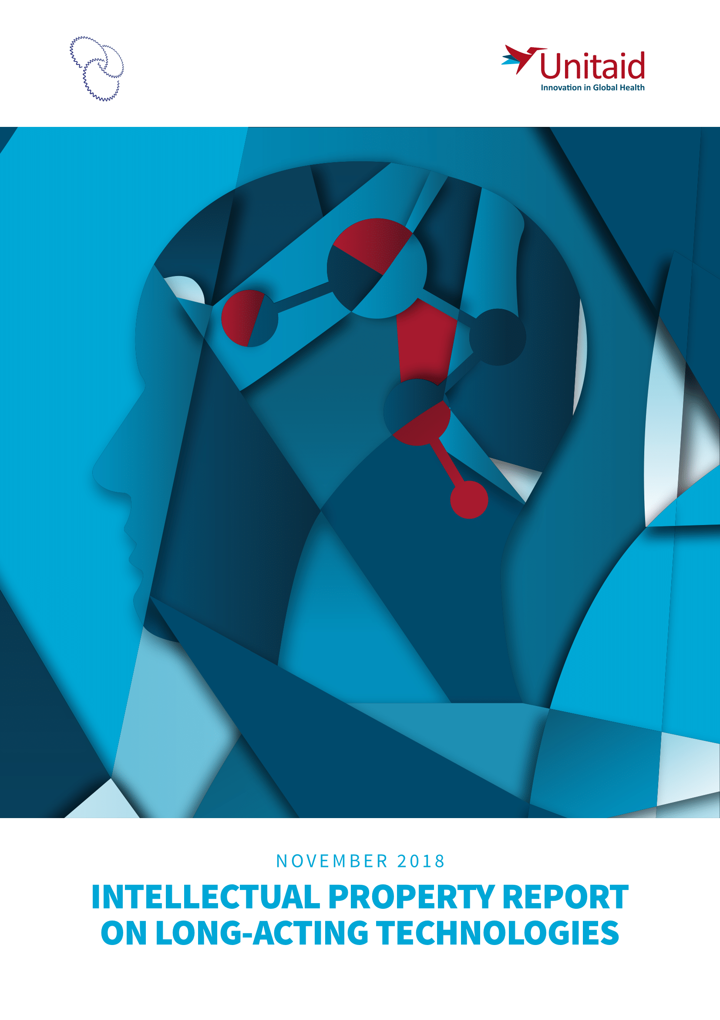
Long acting technologies: Intellectual property landscape
Long-acting technologies MPP/Unitaid report on the patent landscape for long-acting technologies with potential impact for preventing or treating major diseases in low- and middle-income countries
Available at https://bit.ly/2xOrGiK
Notes:
MPP/Unitaid Intellectual Property Report on Long-Acting Technologies

Slide 11
Long acting technologies: Findings from IP landscape analysis
LA technologies often have multi-layered protections on the molecule, the formulation, the delivery device, and the process of manufacturing, potentially providing additional years of exclusivity for the LA product.
Patented platform technologies can be applied to multiple products. Frequently a licence is granted to a specific product using such technology, rather than to the entire platform.
Geographical coverage of patent filings often varies by product/technology. Smaller corporations and academic institutions tend to file in less LMICs compared with major pharmaceutical companies. Key manufacturing countries (e.g., India and China) are often covered.

Slide 12
Long acting technologies: Long-acting Technology Access Hub
The MPP is entering an exploratory phase to determine whether, and how, the MPP model can be applied to facilitate the development of long-acting formulations of public health importance in LMICs
The MPP is proposing to establish a Long-acting Technology Access Hub
Seeking commitments for collaboration /licensing on development of priority products and technologies
Expanding access to drug/device/delivery platform combinations of emerging long-acting products
Facilitating information sharing to maximize potential of long-acting pipeline for LMICs
Working closely with existing initiatives that are active in the long acting space
This exploratory phase is supported by Unitaid
Notes:
Unitaid funded Collaboration hub for long-acting technologies

Slide 13
Long acting technologies: Examples of patent pooling
Supporting development of and access to the most optimal medicine/platform pair (ILLUSTRATIVE ONLY)
GLE/PIB (G/P)
TAF, FTC, DTG, BIC CAB, EfDA, GS-CA2,
LA injectables
HCV For for one-shot cure
Malaria For prophylaxis
HIV For PrEP or treatment
TB For DR-TB and LTBI treatment or preventing transmission
AMR One-shot new antibiotics for good stewardship
BDQ, DLM, others
Atovaquone, Ivermectin
Medicines
Platforms (Licences would likely be product-specific)
Removable depots
HIV For PrEP or treatment maintenance
HBV Current treatments and future functional cures
Malaria For vector control
LA injectables
Product development
by partners
Depots –
biodegradable
Depots –
non-biodegradable
LA orals
Malaria For vector control
HIV For PrEP
LA orals
Microneedle patches (MAPs)
Microneedle
patches (MAPs)
HIV Treatment or PrEP. For neonatal prophylaxis
+ Other patents that could hinder freedom to operate
+ other disease areas that could benefit from LA/ER
Notes:
Facilitating development of and access to long-acting formulations (medicines and delivery mechanisms)

Slide 14
Take-home messages

Slide 15
Take-home messages: New paradigms on Access-oriented licensing
Access-oriented licensing can support new ART approaches, including new paradigms:
Facilitating the development and access to new triple-therapy combinations (e.g. TLD, TAF/FTC/DTG)
Facilitating access to new dual therapies (e.g., DTG/3TC)
Facilitating development of and access to long-acting formulations (medicines and delivery mechanisms)
The MPP looks forward to working with all stakeholders in the emerging long-acting space.
“To avoid the pitfalls the past, when new medicines were introduced first in
high-income countries and only much later in LMICs, we need to be thinking ahead of the curve to prepare for a healthy market and prompt access to these game-changing long-acting tools”
Lelio Marmora
Executive Director, Unitaid
Source: MPP 2018 Annual Report: Expanding Access to Public Health

Slide 16
Thank you! WWW.medicinespatentpool.org www.medspal.org @MedsPatentPool
Contact details
Charles Gore Executive Director cgore@medicinespatentpool.org
Sandra Nobre Business Development Director snobre@medicinespatentpool.org
Esteban Burrone Head of Policy eburrone@medicinespatentpool.org
Sébastien Morin Policy and Advocacy Manager smorin@medicinespatentpool.org

